Slide 1
The Fur Trade in Canada
What is the Fur Trade??
Fur Trade: An industry dealing with the trapping of animal furs and trading them for other desired items such as metal hatchets, pots and glass beads.

Slide 2
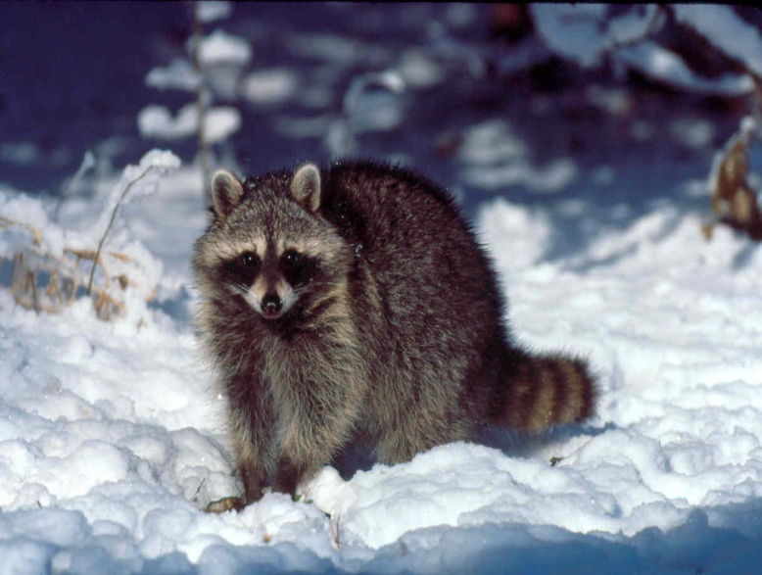
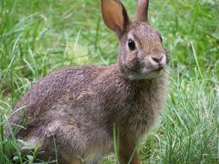
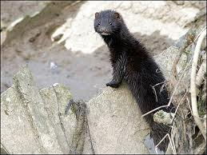
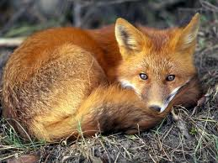
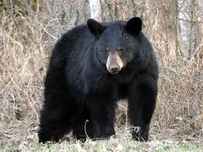
Animals

Slide 3
How did the Fur Trade Begin?
At first, European explorers were looking for gold, silver etc. in North America
In 1534, Jacques Cartier set sail from France hoping to find the Northwest Passage
He travelled to the Gulf of St. Lawrence River and came into contact with First Nations
Trading began by first trading European knives for the First Nations’ furs

Slide 4
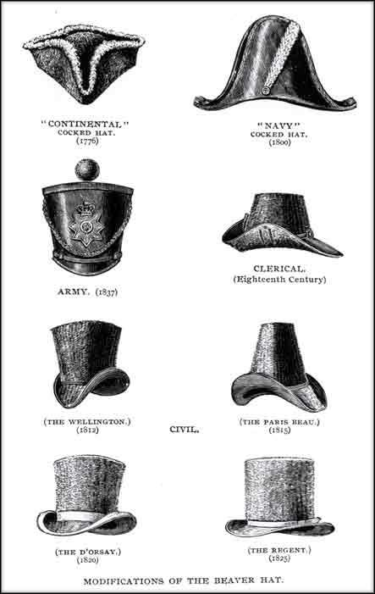
The Importance of the Beaver
By the year 1600, the need for more beaver fur exploded.
Beaver pelts were desired by Europeans for fashion such as hats.
Fur was valuable because it is waterproof, moldable, and durable. The best furs, like beaver, are very soft and smooth.
Were a symbol of social superiority

Slide 5
How did the Fur Trade Begin? (Continued)
Samuel de Champlain discovered the potential of trading fur in 1603 and was given permission by the King of France to establish a Fur Trade
The English saw the benefits of such trading and competition soon began between the French and English

Slide 6
Hudson’s Bay Company and its Charter Monopoly
In 1669, Radisson and Des Groseilliers travelled to England to convince King Charles II of the potential wealth of the Fur Trade around Hudson’s Bay.
If they had his backing, they would help him get the portion of the Fur Trade controlled by the French.
Prince Rupert (cousin of King Charles II) had partners who traded around the Hudson’s Bay. They became known as the Hudson’s Bay Company
HBC: Founded in 1670 by Pierre-Esprit Radisson and Médard Chouart Des Groseilliers

Slide 7
The King granted the company a Charter Monopoly.
Monopoly means that only certain people or business controls a particular area and all that occurs within it.
What does this Monopoly mean for the HBC?
The HBC controlled all of Rupert’s Land. No one could trap animals or trade within the HBC’s boundaries. No French, Dutch, or anyone else allowed!!

Slide 8
HBC Trade Routes & Rupert’s Land

Slide 9
The Hudson’s Bay Company Continued…
Rupert’s Land consisted of all lands drained by rivers flowing into Hudson’s Bay
“stay by the bay”: didn’t want to risk sending traders inland so built forts at the mouths of rivers emptying into Hudson Bay
Encouraged Assiniboine, Cree, and Ojibwa trappers to bring their furs to HBC forts to exchange for trade goods
Beaver was the most prized fur and was made into a form of currency by the HBC.
Very strict standard for trade with little room for bargaining
Very rigid hierarchy in the HBC

Slide 10
Company was run from London, England.
Trading posts were known as “factories” because the head trader was called “the Factor”.
Factors, clerks, and labourers were all British.
All employees collected a salary. Only partners in England collected profits from the Fur Trade

Slide 11
The North West Company
After the fall of New France, Scottish and American capitalists who moved to Montreal, began the re-establishment of old fur-trading companies.
Became known as “Montrealers”.
Established in 1783, became rival to HBC.
Despite being owned by English merchants, continued to employ French-Canadian fur traders

Slide 12
NWC posts were all over the western and northern interior
Posts were more accessible for native traders.
Too far to travel to Montreal so furs could be shipped to England
Many native trappers and traders lived west of Lake Winnipeg
Major trading post was Fort William, located at the head of Lake Superior.

Slide 13
Spring: trade goods shipped from London to Fort William, NWC transported goods to inland posts.
Summer: reverse. Furs to Montreal.
Short ice-free season on lakes and rivers.
NWC: aggressive operation
Structure based on partnerships
Much less rigid than the HBC
By late 1780s, HBC established inland posts to take back some of the territory that was lost to the NWC.
COMPETITION!

Slide 14
Fort William

Slide 15
NWC Trade Routes

Slide 16
NWC continued…
Easier for Native trappers to trade at these posts because they didn’t have to travel to Hudson Bay
Hivernants (wintering partners) stayed in the Northwest and did the trading
Shared in the profits because they were partners.
Employed voyageurs to carry cargo in the Northwest and on the long lake journey from Fort William to Montreal.
Looked for new trading areas
Employed explorers to map new territories and establish new posts in the Northwest.

Slide 17
Willing to negotiate prices
Would trade alcohol for furs – HBC would not.
By 1800, trade network stretched as far west as the BC interior and as far north as Great Slave Lake.
Strongly motivated to prosper because profits were shared

