Slide 1
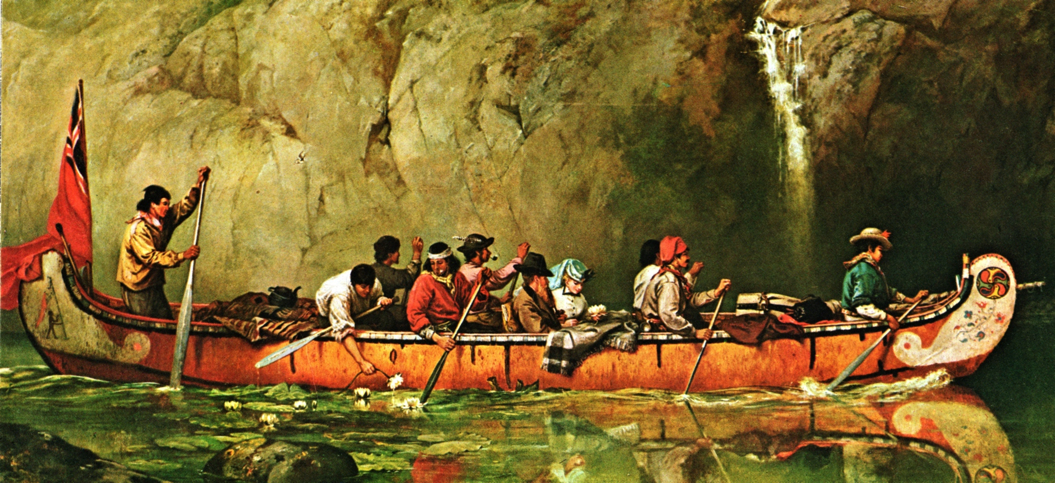
The Voyageurs

Slide 2
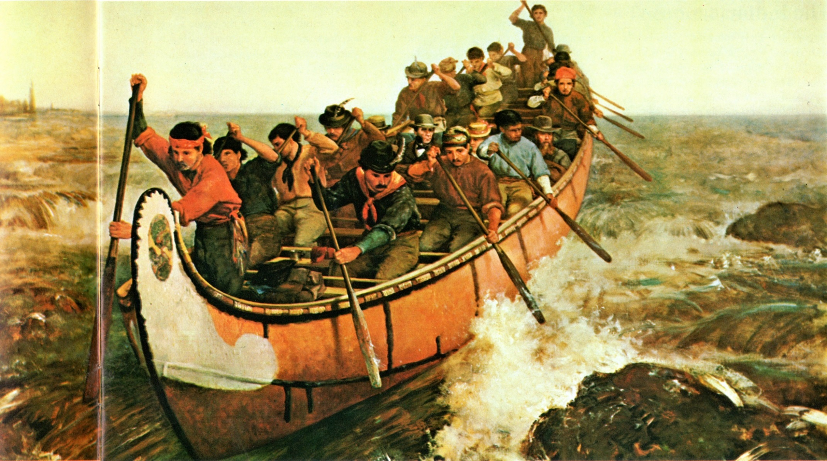

Slide 3
The Voyageurs
Worked for the NWC
Relied on canoes to transport furs and goods from Fort William to Montreal.
Entire distance from the Rocky Mountains to Montreal could be travelled by water. It was very difficult and dangerous.
The trip had two stages:
Stage 1: from Montreal, they travelled up the Ottawa, across the Mattawa, Lake Nipissing, and the French River, then across the northern part of Georgian Bay and along the shore of Lake Superior to Grand Portage (Fort William).

Slide 4
Stage 2: trade goods loaded into smaller canoes, transported through the Lake of the Woods/Rainy River system to Lake Winnipeg, then on to the Saskatchewan and other rivers.
There were 38 portages between Fort William and Lachine! (near Montreal)
During a portage, they would carry 55kg bales of goods known as pieces, through narrow trails, around waterfalls and rapids.
Most Voyageurs could carry 2-3 bales at a time!
Also had to carry their canoes until they joined the next river system.

Slide 5
Portage:

Slide 6
Were almost always Canadiens.
Distinguished themselves as either “pork-eaters”(worked from Great Lakes eastward), or “winterers” (west of the Great Lakes).
Famous for their strength and endurance.
Paddled for fifty minutes and hour, forty to fifty strokes per minute, fourteen hours per day!
Stopped only briefly for ten-minute smoke breaks known as “pipes”.
Sang songs to keep themselves entertained.

Slide 7
At camp:
Main meal was cooked dried peas or cornmeal, mixed with water and bits of lard or pemmican
Also made a type of bread called galette.
After dinner, they smoked their pipes, told jokes, then went to sleep.
Slept under their canoes for protection from the elements when necessary.

Slide 9
Voyageur Canoes
Known as Canots de Maitre
11 meters long, 1.5 meters wide, 12 person crew
Up to 4000 kg of cargo
Made of birch bark stretched over a wood frame
Paddled and portaged their canoes across thousands of kilometers of rivers and lakes between interior posts and the main depots of Fort William and Montreal.

Slide 11
Lachine

