Slide 1
The United Nations and the Suez Crisis

Slide 2
The United Nations
1945: Created in San Francisco with four basic goals or otherwise known as THE UN MANDATE:
World peace
Cooperation among nations
Defending human rights
Improving the standard of living for all nations

Slide 3
Structure of the UN
The General Assembly:
Each member state has one vote
2/3 majority to pass on important issues
Discuss issues related to world peace
No power to enforce decisions, can only make recommendations

Slide 4
2) The Security Council
Responsible for maintaining world peace
5 Permanent members: China, France, the UK, US, Russia
10 temporary members serve two year terms - elected to Council
1948 - 1950: Canada gained seat on council

Slide 5
Majority of at least 9 – 15 required for any resolution to pass
‘Veto Power’ a.k.a ‘Great Powers Unanimity’: on very important issues all 5 permanent members must vote yes.
So on the most pressing issues, even if you have a 9 – 15 majority, if 5 out of 9 are not permanent member votes, the resolution will not pass.

Slide 6
1) UN recommend conflicting parties reach agreement by peaceful means
2) End disputes that lead to fighting ASAP
Cease fire directives
UN peacekeeping forces - help reduce tensions, separate fighting sides and create calm negotiating conditions
3) Enforcement measures
Economic sanctions (trade embargoes)
Collective military action

Slide 7
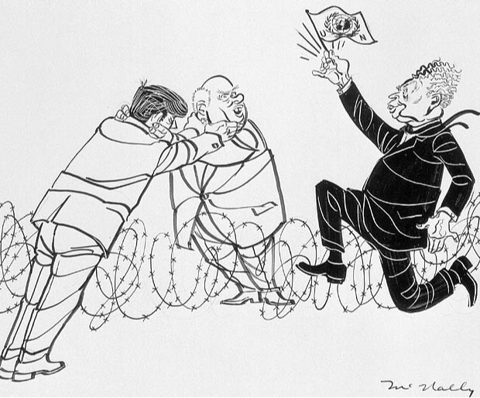

Slide 8
The Korean War
Communist N. Korea (supported by Soviet Union and China) invaded democratic S. Korea (supported by the US)
The First shot fired in Cold War
Korea was not on the the US list of countries it was willing to defend.

Slide 9
Enter the United Nations:
A chance to restore peace by honouring the principle of collective security.
UN Security Council passes action against aggression in South Korea.

Slide 10
The Armistice
UN forces comprised of 32 countries but dominated by Canadian and American forces pushed back the North Koreans and position themselves too close to the Chinese border.
China rushed 200,000 volunteers and pushes the UN forces to the 38th parallel.
President Truman, wishing to avoid a full scale conflict with China, negotiates an armistice.
1953: Armistice signed dividing Korea between North and South at the 38th parallel.

Slide 11
Canada’s Role in Korea:
25, 000 soldiers saw action in the war and were convinced they were supporting the ‘free world’ in a fight to stop the spread of communism.
Significance:
Connection to British foreign policy replaced with American foreign policy. As was often the case in the cold war, Canada found itself on the same side as the US but not always agreeing with everything the US wanted to do.

Slide 12
Lester B. Pearson and the Suez Crisis
The Rise of Middle Eastern Nationalism and the Role of Canada as peace-keepers:
The Suez Canal Crisis – 1956
Disputes erupt in Egypt over control of the Suez Canal

Slide 13
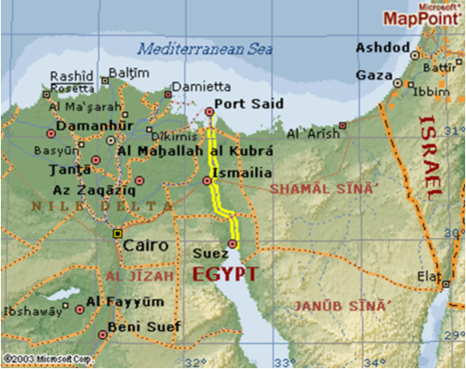
The Suez Canal

Slide 14
Background to the Suez Crisis
Canal opened in 1869 - financed by French and Egyptian governments.
Important strategically: links Red Sea and Mediterranean Sea
2/3 of Europe’s oil passes through canal.
1875: Egyptians forced to sell their shares (control) in the canal to the British
1950’s: Canal owned by British and French

Slide 15
Egyptian President Gamel Abdul Nasser: Egyptian Nationalist
As Britain was withdrawing from Egypt, Nasser began completion of the Aswan High Dam project across the Nile river.
In 1956 because of Nasser’s dealings with the USSR, Britain and the US cut off aid for the Aswan project.
Nasser decided to nationalize the Suez Canal, which incensed the British and French who then decided to invade and occupy Egypt

Slide 16
The Suez Canal Crisis: Continued
Canada was concerned about the effect of the Suez Crisis on international relations
Canada realized that while the US might not agree with Nasser’s actions, they would not support Britain in an aggressive action against Egypt.
Israel feeling threatened by Egypt, planned to invade with the support of France and Britain
Ignored UN Security Council recommendation to cease hostilities
US was angry at its allies (Britain, France, and Israel) for not consulting them before attacking Egypt.

Slide 17
The USSR responded with an ultimatum: Atomic Bombs would rain down on London and Paris if the invasion did not end.
US threatened retaliation against any Soviet involvement
Lester B. Pearson proposed that a UN Emergency Force be sent in to separate and mediate between the rival armies in Egypt.
Proposal is accepted and Canada supervises a peaceful withdrawal, allowing the other countries involved in the conflict to save face.

Slide 18
Lester B. Pearson is awarded the Nobel Peace Prize for his efforts in defusing the Suez Canal Crisis.

Slide 19
Homework:
Read pages 140 - 144 in Counterpoints.
Research: Has the UN succeeded or failed in its mandate over the past 60 years? Provide three examples to support either view. Be prepared to share!

